Slide 1
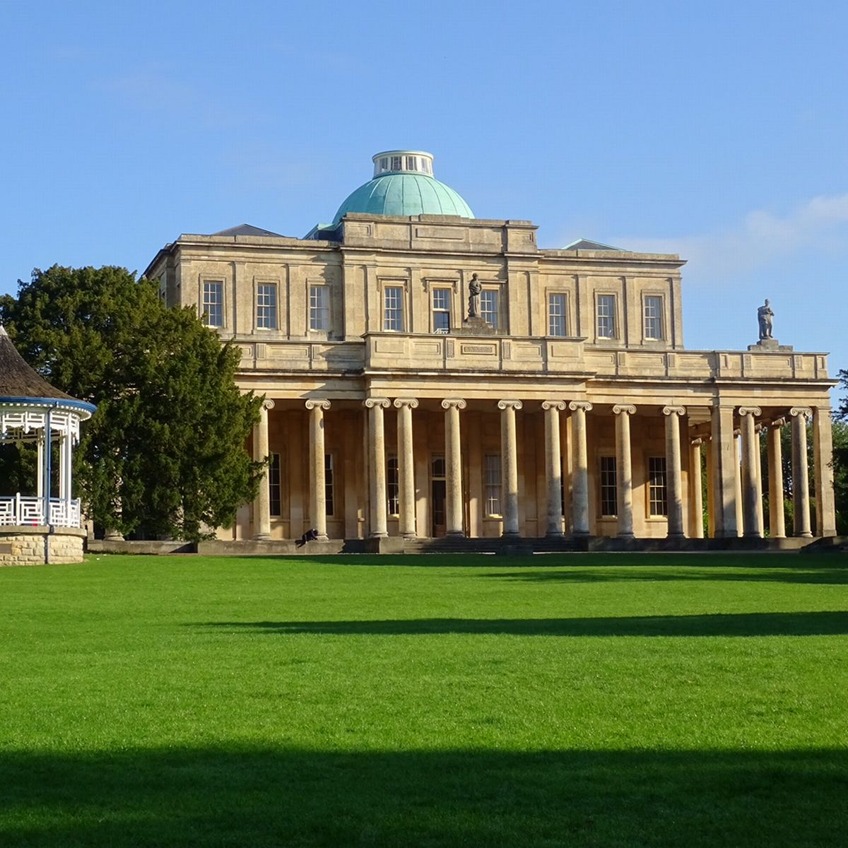
UKCS 2024
Cheltenham, Gloucestershire

Slide 2
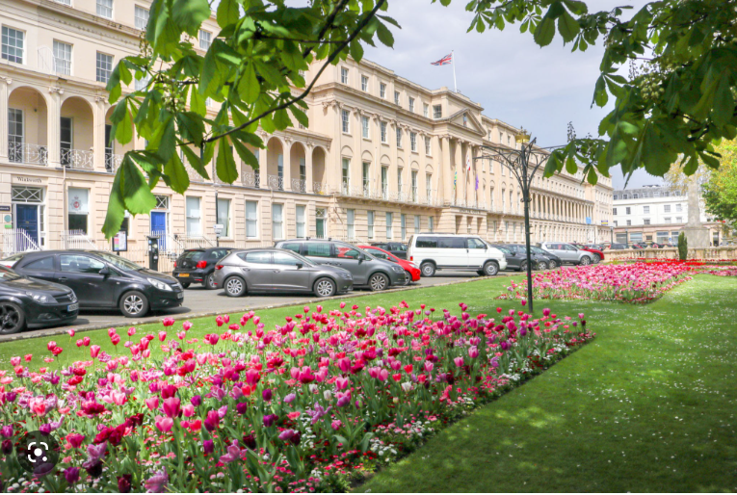
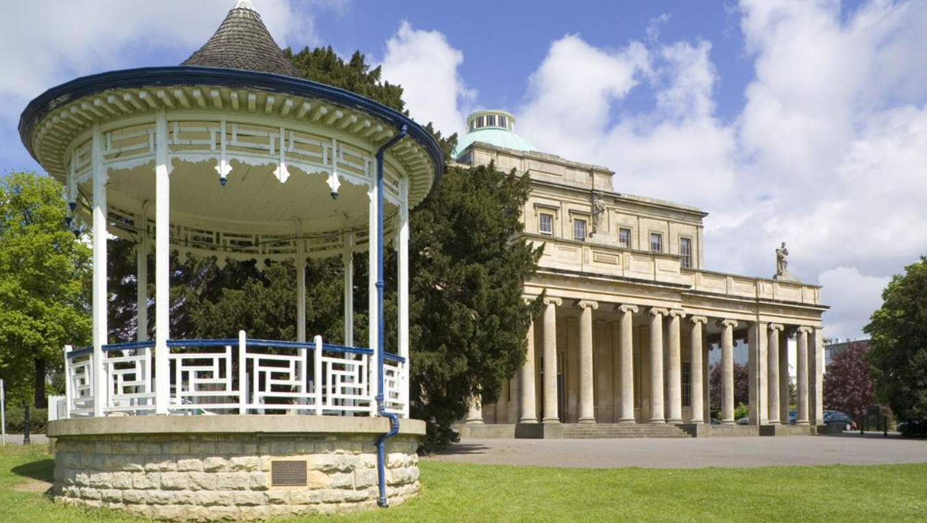
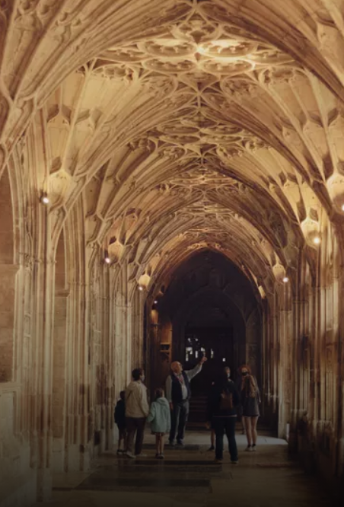
Why visit Gloucestershire?
Spa town
Cotswolds
Gloucester Cathedral
Gloucester Rugby
Cheltenham Racecourse
The Cotswolds
Easy Access

Slide 3
Our Team: Breadth and Depth
Urogynae Consultants
Colorectal Consultants
Microbiology Consultant
Pain Consultant
Advanced Urogynaecology Practitioners (Nurse and Physio)
Nurse Practitioner
Pelvic Health Physiotherapists
Continence Nurses
Specialist Midwife

Slide 5
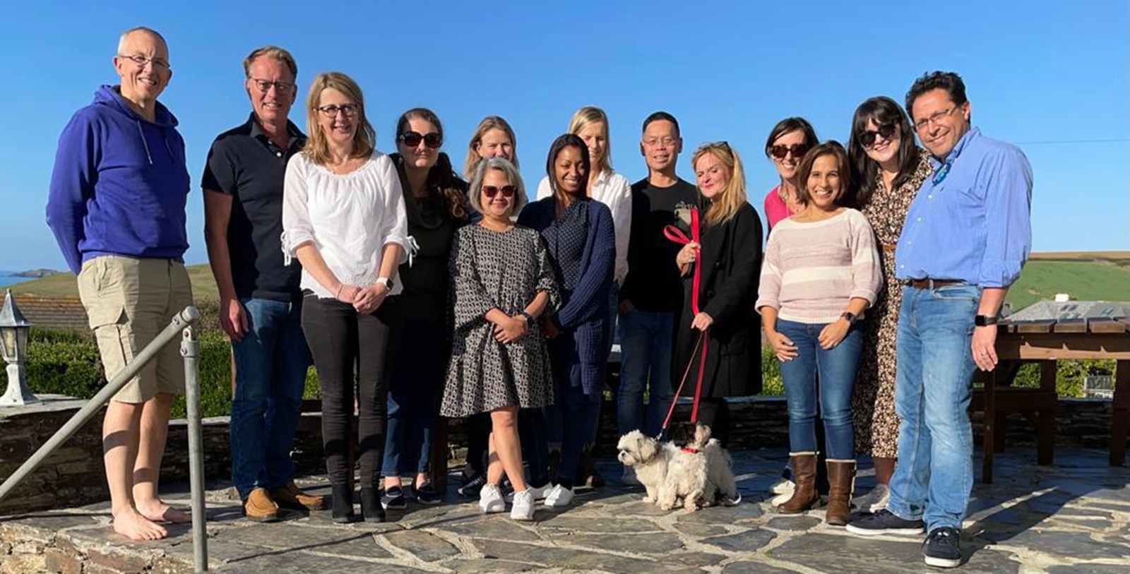

Slide 6
UKCS - Themes
The frail/older patient – “Dealing with Dementia”:
Relatives
Clinical staff
Management options

Slide 7
UKCS - Themes
The frail/older patient – “Dealing with Dementia”:
Relatives
Clinical staff
Management options
Advances and innovations in Education for:
Patients
Clinical Staff

Slide 8
UKCS - Themes
The frail/older patient – “Dealing with Dementia”:
Relatives
Clinical staff
Management options
Advances and innovations in Education for:
Patients
Clinical Staff
Recurrent UTI’s
Complex UTI MDT and newer management options
Primary care
Integrated working relationships with the community

Slide 9
See you next year!

